Slide 1
Leaf Healer: A Mobile Application for Plant Leaf Disease Detection
Presented By: Afrin Rahman ID: 11200120498 Department of Computer Science and Engineering, NUBTK
Supervised By: Md. Azizul Islam Lecturer Department of Computer Science and Engineering, NUBTK

Slide 2


Content
Objective
Introduction
Used Technology
Procedure
Result & Discussion
Future Work
Conclusion

Slide 3

Introduction
A cross-platform plant disease detection mobile app made with Flutter.
Easy Disease Identification
Helpful Treatment Advice
User-Friendly Design
Comprehensive Plant Knowledge
Continuous Improvements
Interactive User Engagement

Slide 4
Introduction (Cont..)
AI-Powered Suggestion
Performance Optimization

Slide 5


Used Technology
VS Code

Slide 6
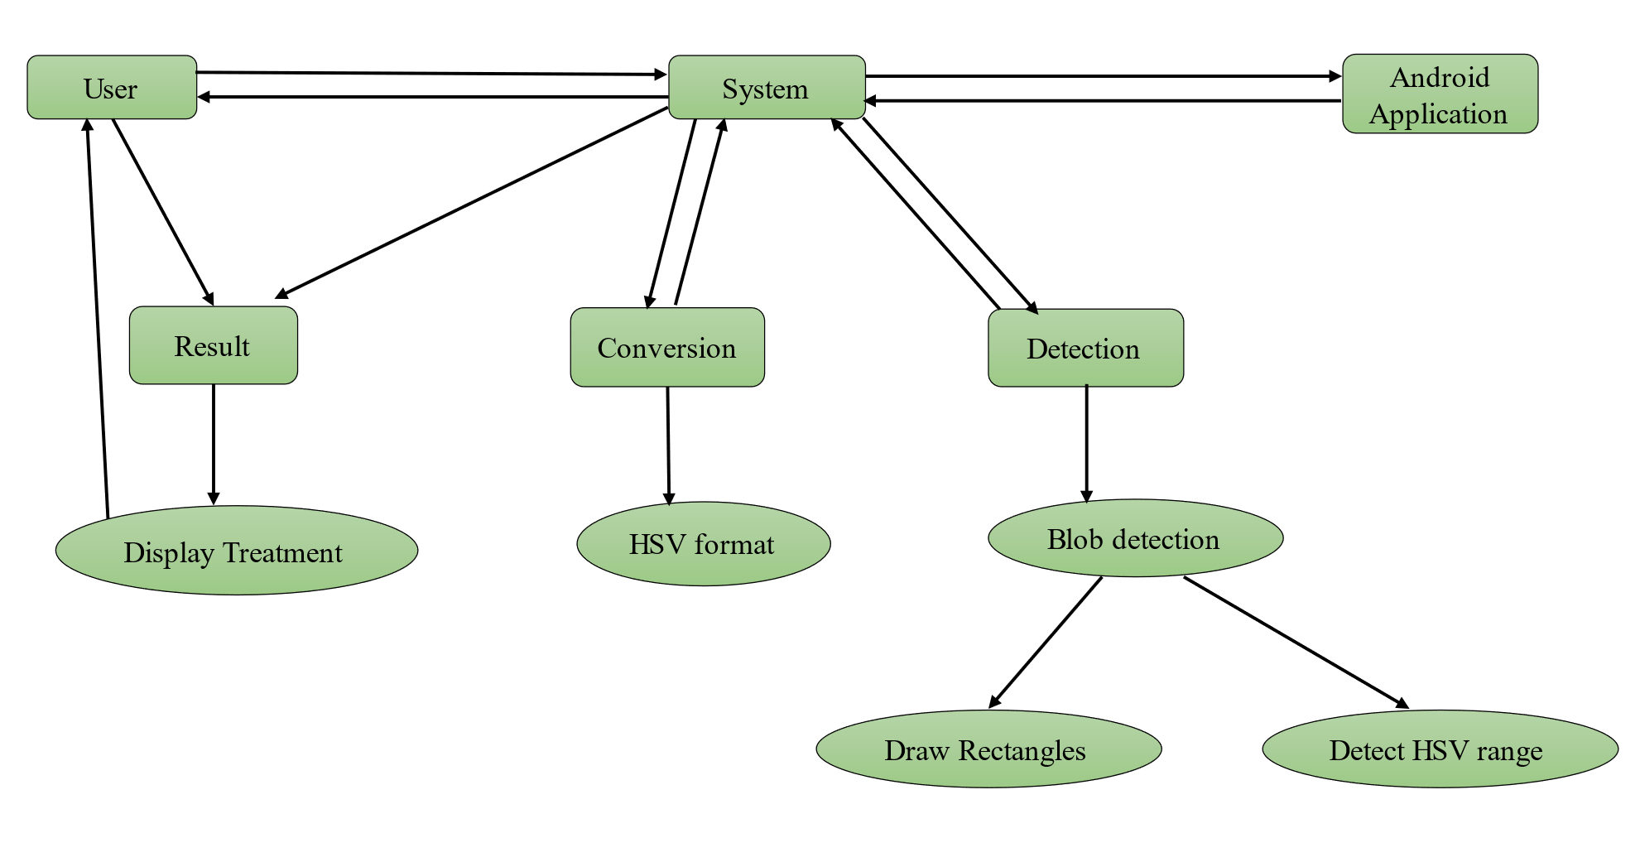
ER Diagram
Fig 01

Slide 7
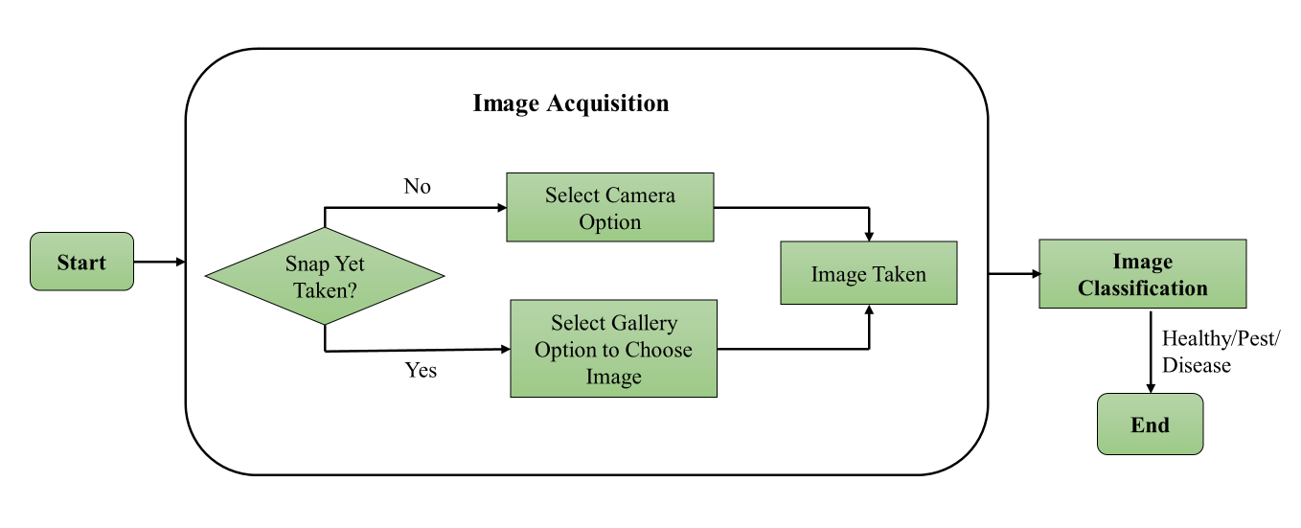
Workflow Diagram
Fig 02

Slide 8
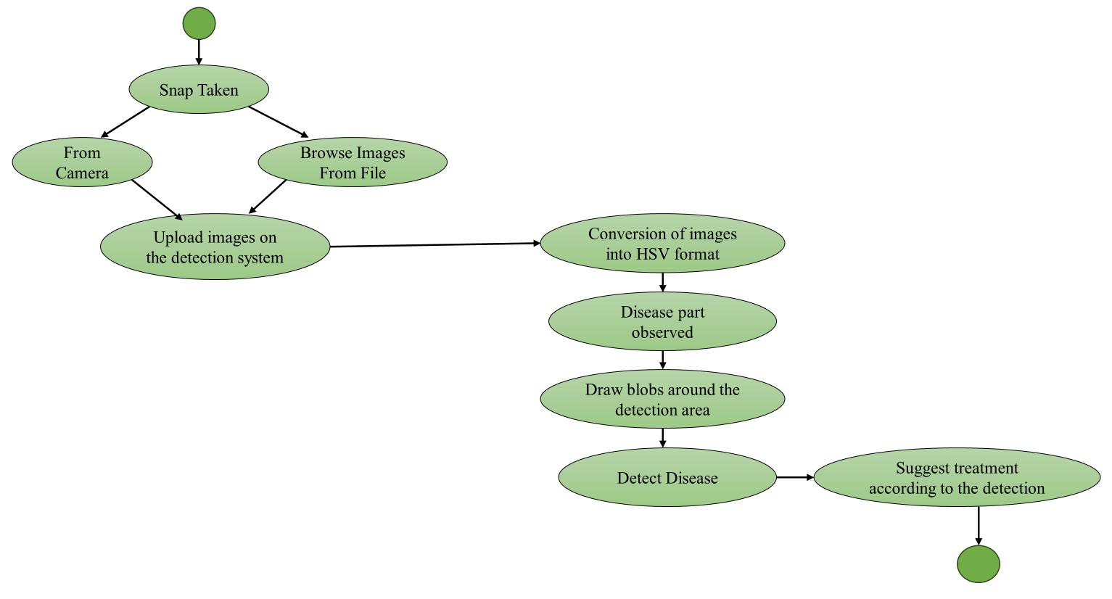
Activity Diagram
Fig 03

Slide 9
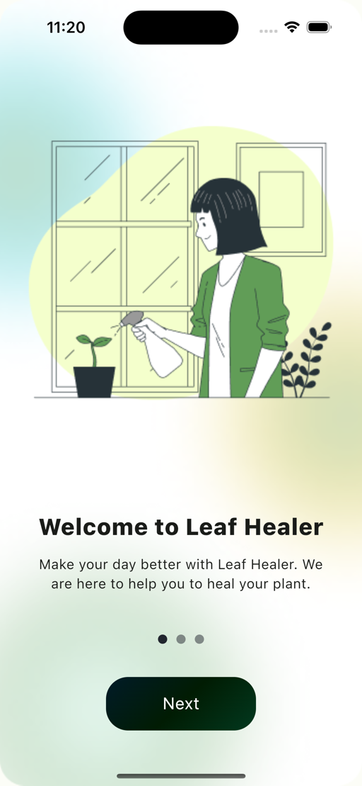
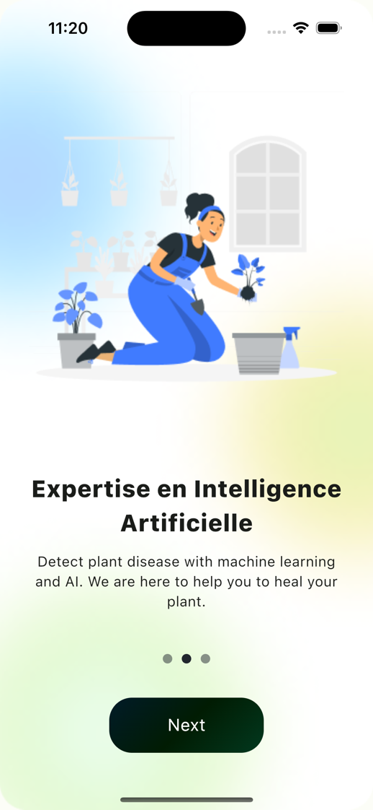
Intro
Intro -1
Intro -2

Slide 10
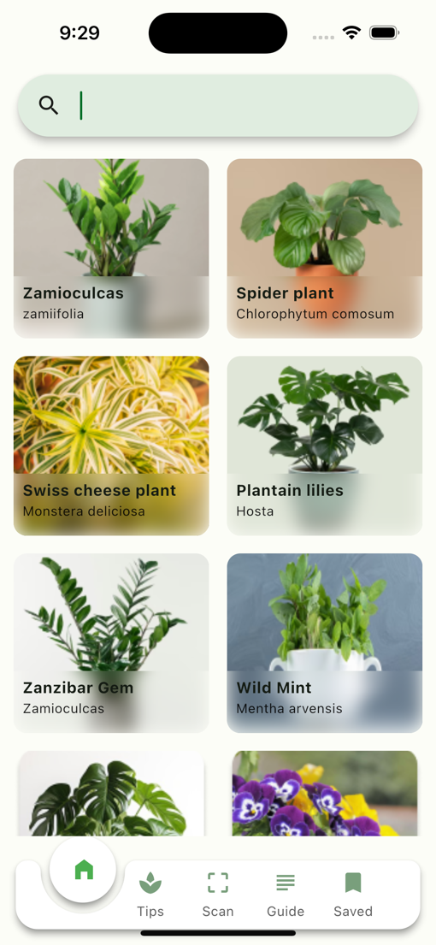
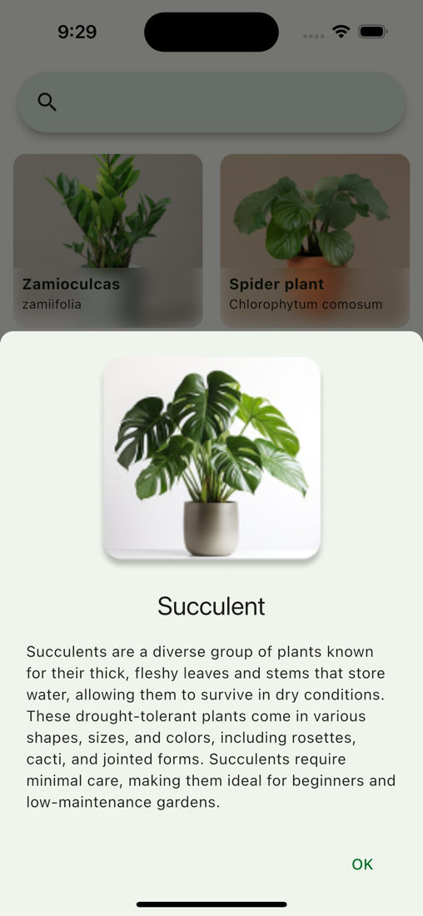
Home Screen
Plant Card
Plant Details

Slide 11
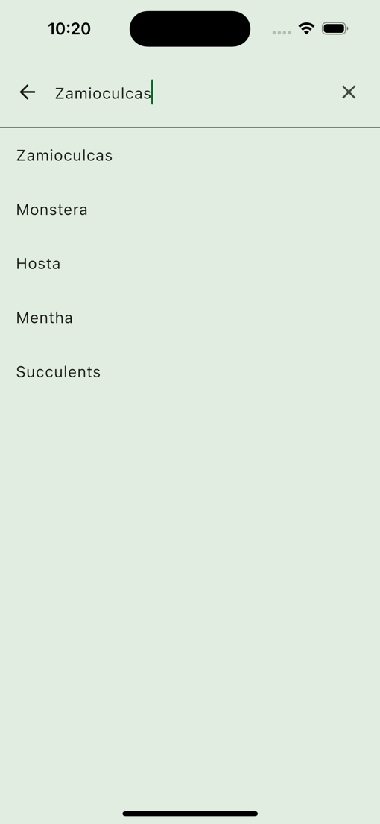
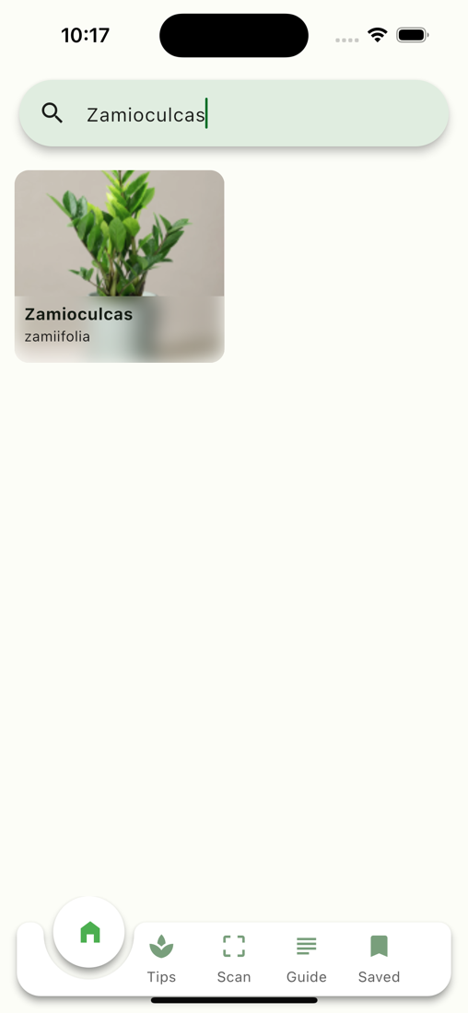
Search Plant
Search plant by name
AI-Powered search
A large number of plant
Suggest relevant result
Plant details

Slide 12
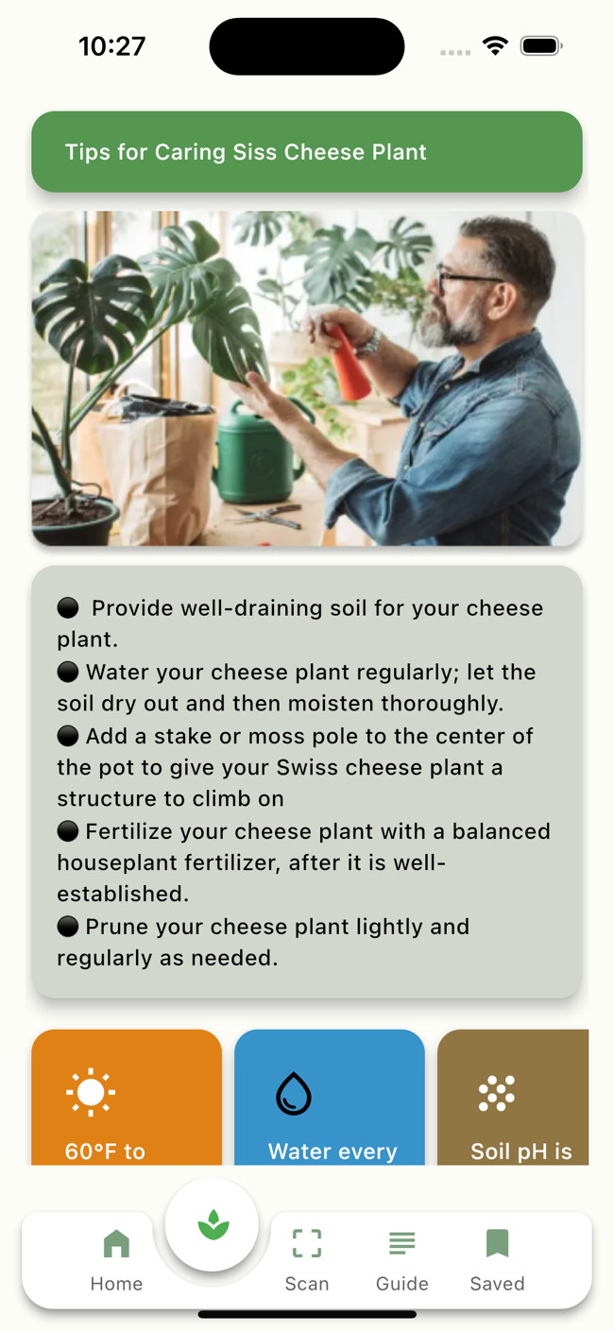
Tips
Tips for caring for plants
Image guide for different plant
Interactive suggestion
User-friendly design

Slide 13
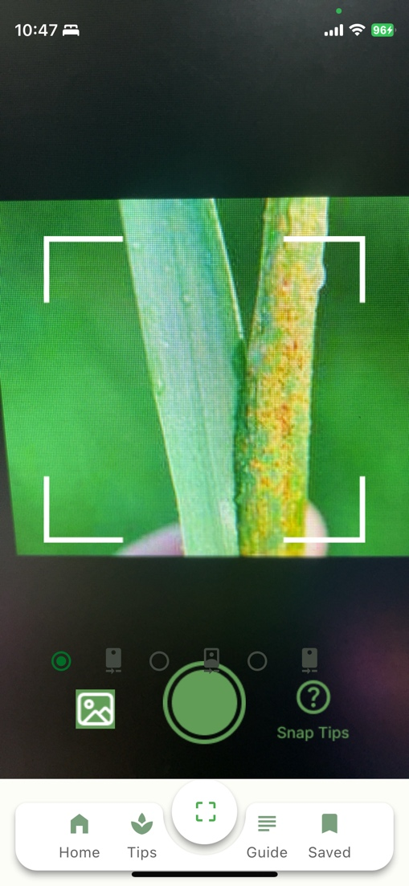
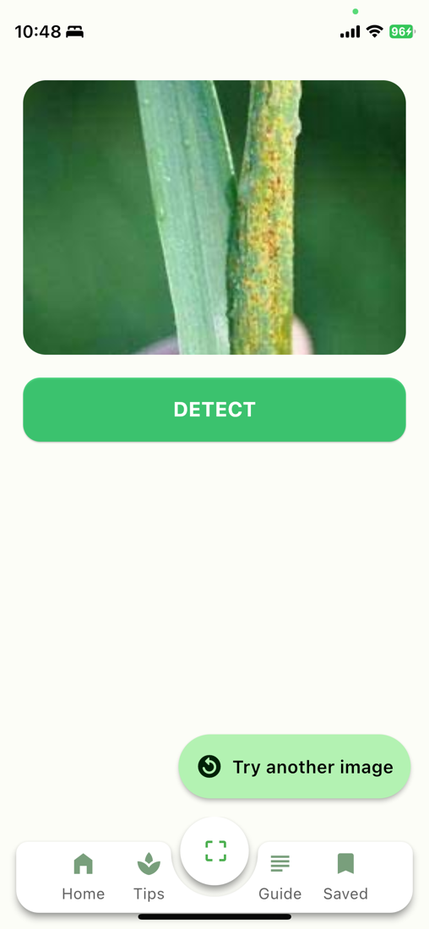
Detect Disease Using Camera
Select Camera
Take a picture of a leaf
Send the image to the AI model
Detect disease
Suggest percussion

Slide 14
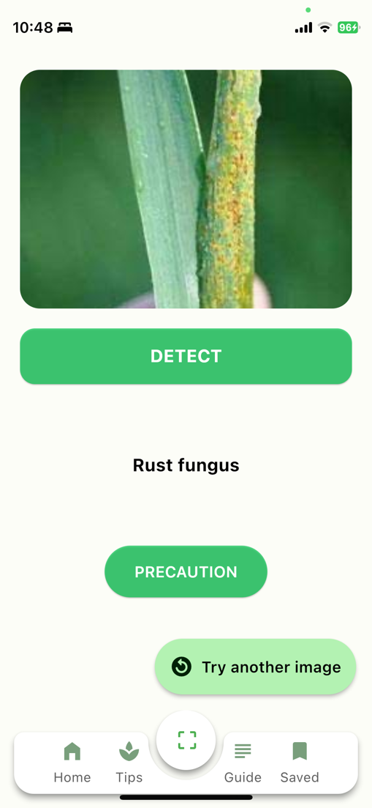
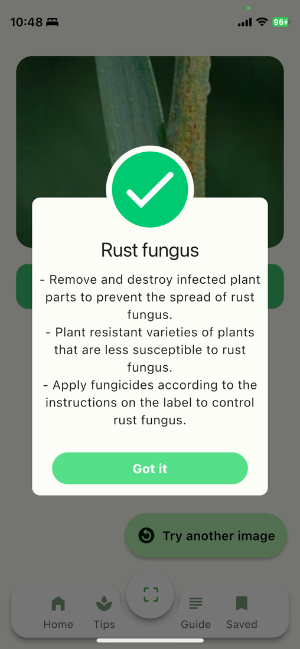
Detect Disease Using Camera
Select Camera
Take a picture of a leaf
Send the image to AI model
Detect disease
Suggest percussion

Slide 15
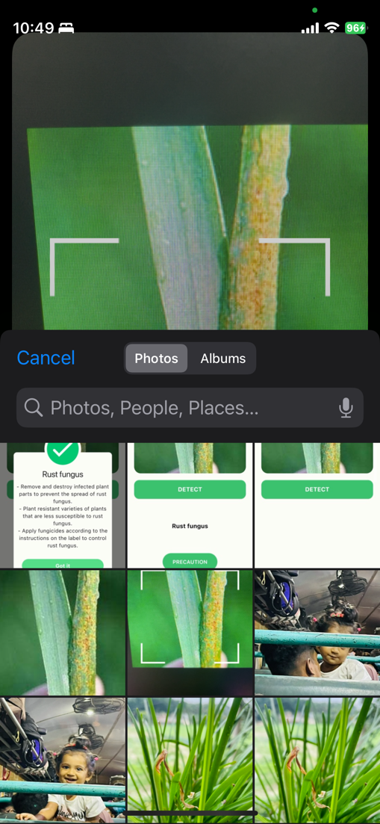
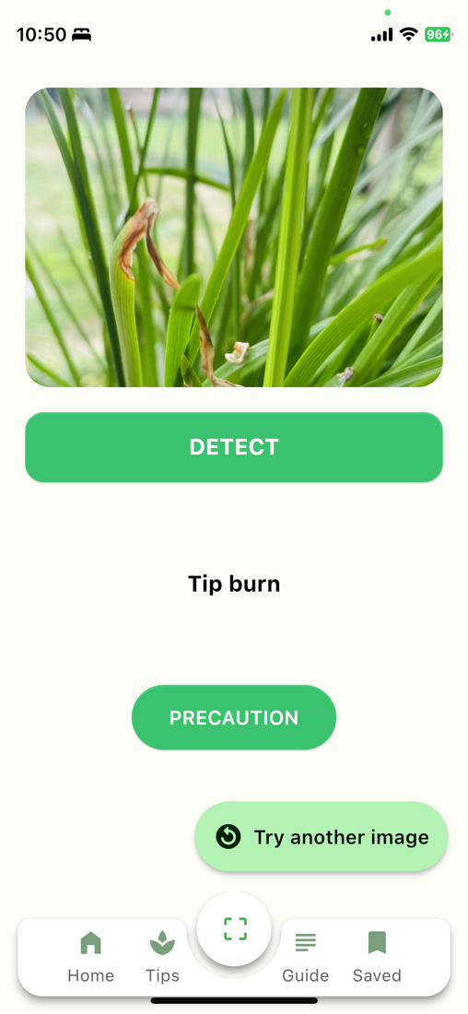
Detect Disease Using Gallery Image
Open Gallery
Select Image
Send the image to AI model
Detect disease
Suggest percussion

Slide 16
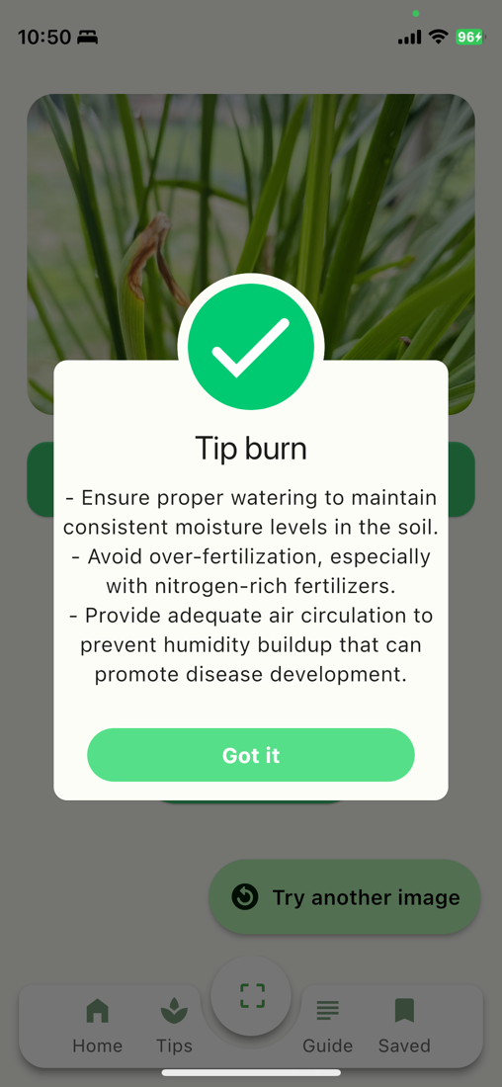
Detect Disease Using Gallery Image
Open Gallery
Select Image
Send the image to AI model
Detect disease
Suggest percussion

Slide 17
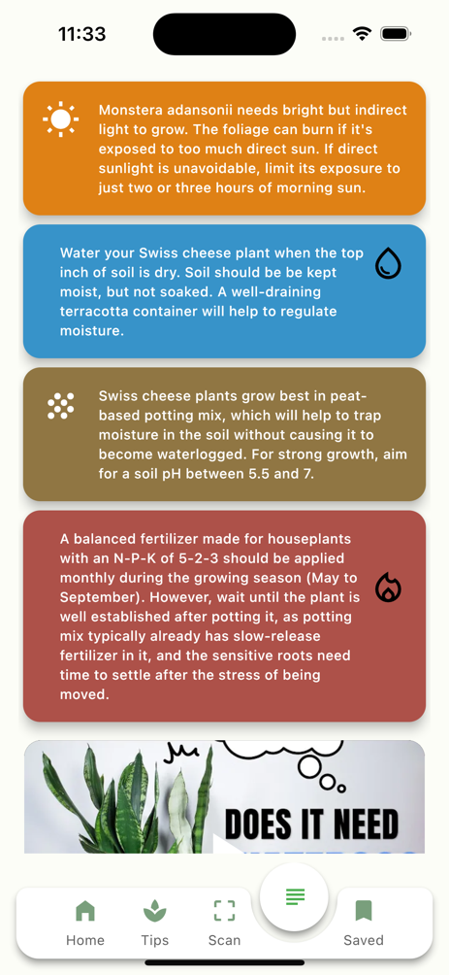
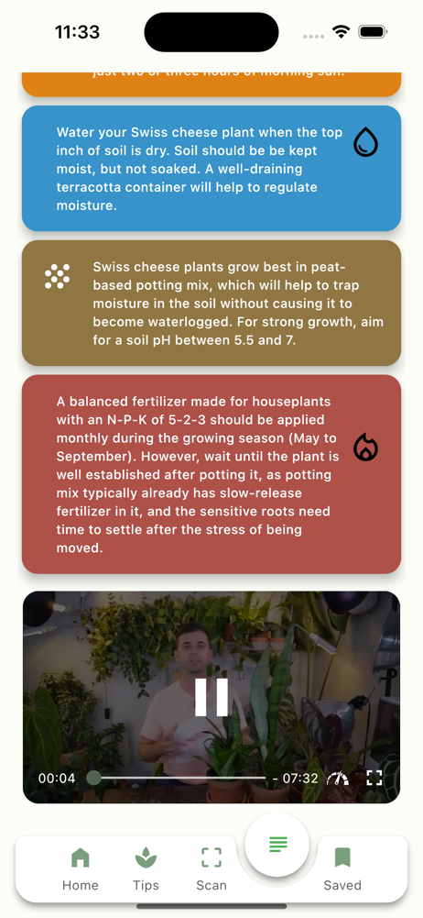
Care Guide
Care guide article
Care guide video
Interactive care guide

Slide 18
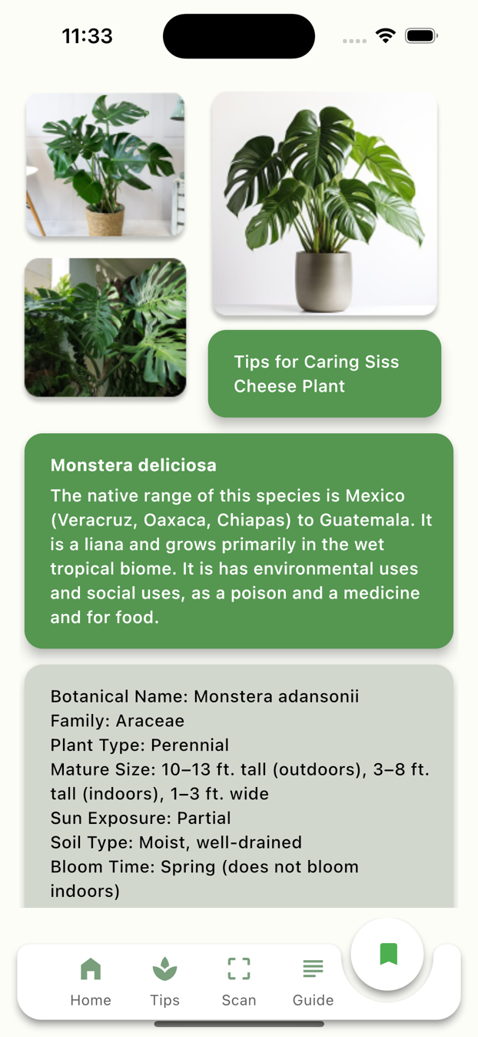
Saved Plant
Save plants as you like
Monitor health conditions
Easy to manage

Slide 19
Future Development
Interactive Learning Modules
Personalized Care Plants
Collaborative Content Creation
Augmented Reality (AR) plant Identifier
Integration With Smart Home Device
Accessibility Enhancements
Subscription Services

Slide 20
Thank You
Github URL: https://github.com/Afrin-Tithi/leafHealer

